Slide 1
Software engineering applied in IoT
INTEGRATION TESTS AND DEVOPS

Slide 2
Agenda
What is software testing?
Integration testing
Testing tools
Testing of mobile applications
Performance testing - JMeter

Slide 3
What is software testing?

Slide 4



What is defect?
Error (mistake)
Defect (fault/bug)
Failure

Slide 5


Causes of Software Defects
Human beings are fallible
Time pressure
Complex code
Complexity of infrastructure
Changing technologies
Many system interactions

Slide 6
What is software testing?
Testing
Planning and control
Choosing test conditions
Designing and executing test cases
Checking results
Evaluating exit criteria
Reporting on the testing proces and system under test
Finalazing or completing closure activities after a test phase has been completed
Reviewing documents (incl. source code) and conducting static analysis

Slide 7
Testing objectives
Finding defects
Gaining confidence about the level of quality
Providing information for decision-making
Preventing defects

Slide 8
Testing principles
Principle 1 – Testing shows presence of defects
Principle 2 – Exhaustive testing is impossible
Principle 3 – Early testing
Principle 4 – Defect clustering
Principle 5 – Pesticide paradox
Principle 6 – Testing is context dependent
Principle 7 – Absence-of-error fallacy

Slide 9
Test levels
Test level– „A group of test activities that are organized and managed together. A test level is linked to the responsibilities in a project. Examples of test levels are component test, integration test, system test and acceptance test.” Słownik wyrażeń związanych z testowaniem, SJSI

Slide 10
Test levels – V Model
Requirment Gathering
Acceptance tesing
System requirments
System Testing
Architecture design
Integration Testing
Design
Test
Low Level Design
Unit Testing
Coding

Slide 11
Test types
Test type– „A group of test activities aimed at testing a component or system focused on a specific test objective, i.e. functional test, usability test, regression test etc. A test type may take place on one or more test levels or test phases.” Słownik wyrażeń związanych z testowaniem, SJSI

Slide 12
Test types
Functional testing(„what” the system does)
The functions are „what” the system does
Non-functional testing („how” the system works)
performance testing
load testing
stress testing
usability testing
maintainability testing
reliability testing
portability testing
Structural testing (white-box testing)
Testing related to Changes
re-testing
regression testing

Slide 13
Integration testing

Slide 14


Integration testing
Integration testing – „Testing performed to expose defects in the interfaces and in the interactions between integrated components or systems. Słownik wyrażeń związanych z testowaniem, SJSI

Slide 15
Common strategies of integration testing
Integration testing
Big bang testing
Top-down testing
Bottom-up testing
Sandwich/Hybrid testing

Slide 16
Big bang testing
Big-bang testing– „An integration testing approach in which software elements, hardware elements, or both are combined all at once into a component or an overall system, rather than in stages.” Słownik wyrażeń związanych z testowaniem, SJSI
System
Module 1
Module 2
Module 3
Module 4
Module 5
Module 6

Slide 17
Top-down testing
Top-down testing– „An incremental approach to integration testing where the component at the top of the component hierarchy is tested first, with lower level components being simulated by stubs. Tested components are then used to test lower level components. The process is repeated until the lowest level components have been tested.” Słownik wyrażeń związanych z testowaniem, SJSI
Module 1
Module 2
Module 5
Module 8
Module 6
Module 3
Module 7
Module 4

Slide 18
Bottom-up testing
Bottom-up testing – „An incremental approach to integration testing where the lowest level components are tested first, and then used to facilitate the testing of higher level components. This process is repeated until the component at the top of the hierarchy is tested.” Słownik wyrażeń związanych z testowaniem, SJSI
Module 1
Module 2
Module 5
Module 8
Module 6
Module 3
Module 7
Module 4

Slide 19
Sandwich/Hybrid testing
Sandwich/Hybrid testing– „Sandwich testing is also known as Hybrid approach in Integration testing. This approach is the combination of bottom-up & Top-Down Approach. In Sandwich testing / Hybrid Integration Testing, we exploit the advantages of Top-down and Bottom-up approaches. As the name suggests, we make use of both the Integration techniques.” Integration Testing Techniques, Kratika Parmar
Module 1
Module 2
Module 5
Module 6
Module 3
Module 7
Module 4
Layer III
M1
M1 – M2 – M3 – M4
M5
M1 – M2 – M3 – M4 – M5 – M6 – M7
Layer II
M2 – M5 – M6
M6
Layer I
M7
M3 – M7

Slide 20
Testing tools

Slide 21
ReST
HTTP
TCP/IP
What is ReST, RESTful Webservices?
ReST - Representational State Transfer
An architectural style
Defined in in Roy Fielding's doctoral dissertation in 2000
RESTful Webservices
Richardson Maturity Model

Slide 22
ReST Principles
Client–server
Stateless
Cacheable
Uniform interface
Layered system

Slide 23


ReST Clients - Postman

Slide 24
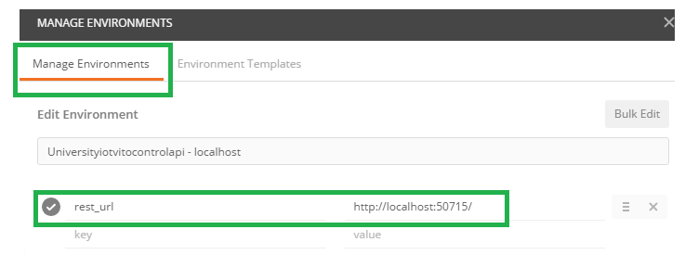
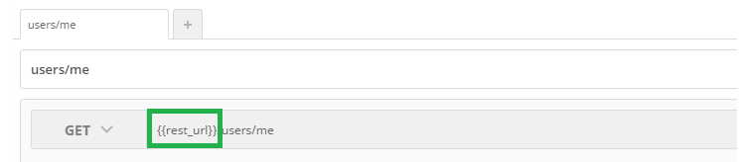
Postman – Manage Environments

Slide 25
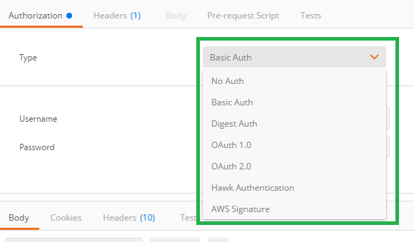
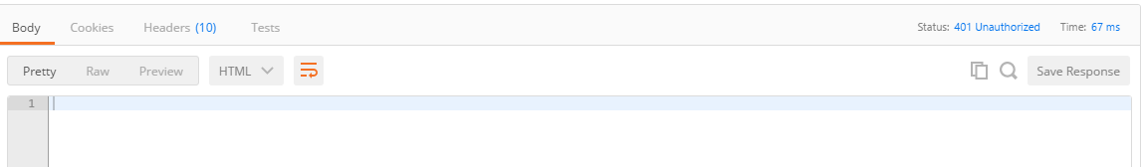
Postman – Authorization 1/2

Slide 26
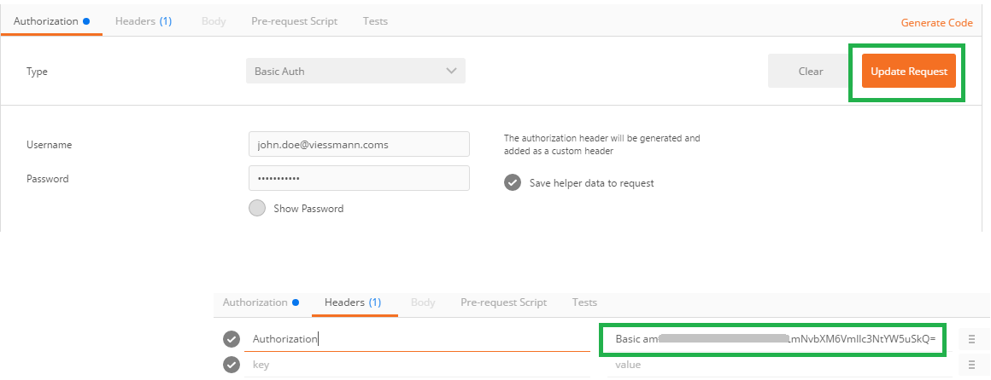
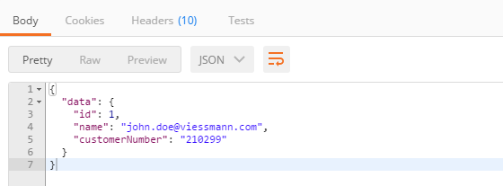
Postman – Authorization 2/2

Slide 27
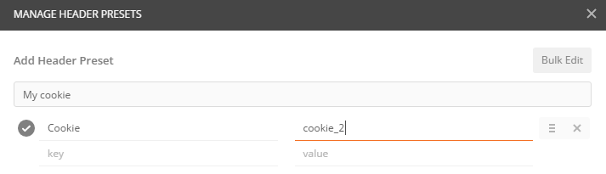
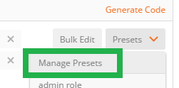
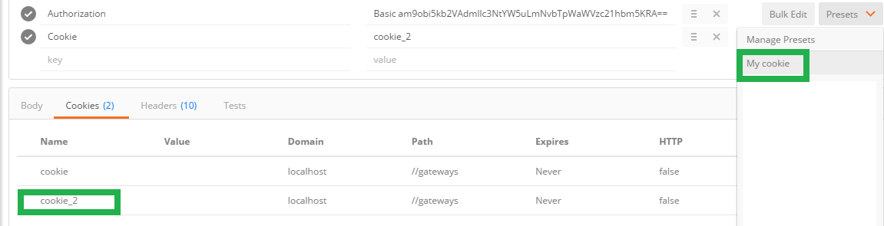
Postman – Presets

Slide 28
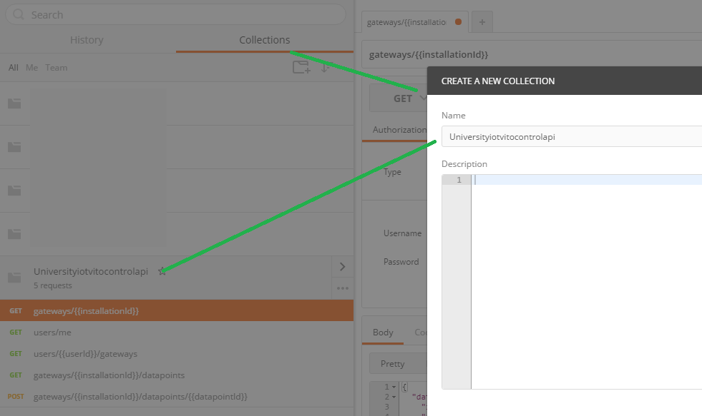
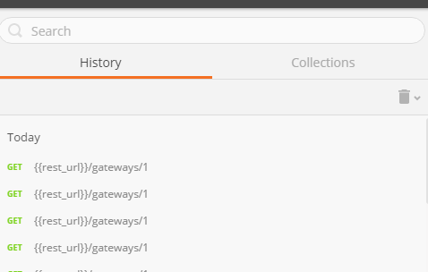
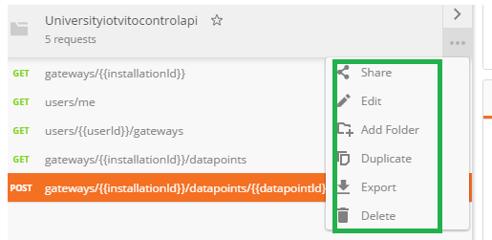
Postman – History, Collections

Slide 29
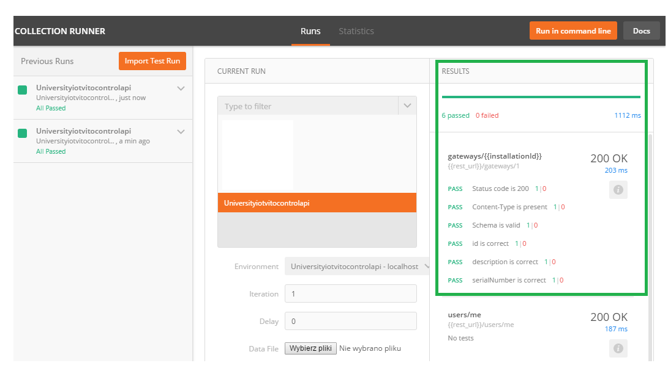
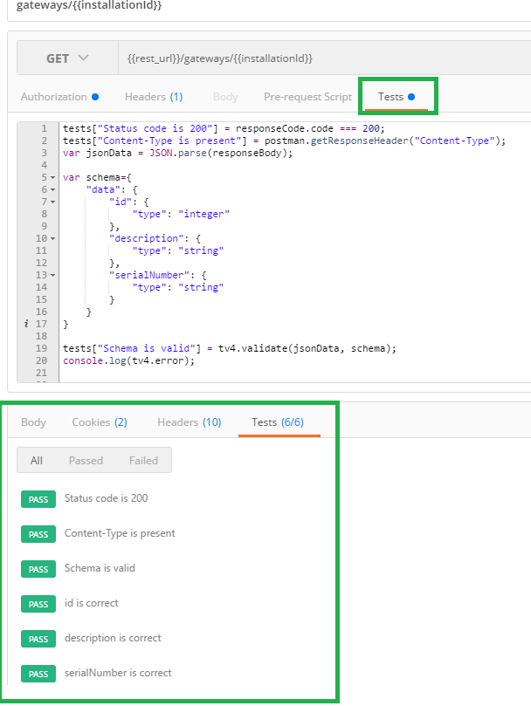
Postman – Tests, Collection Runner

Slide 30
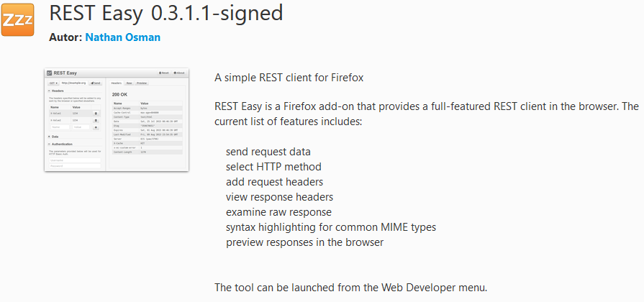
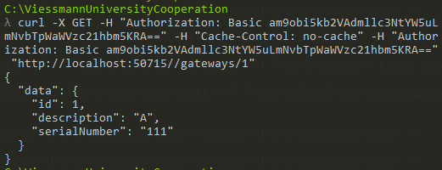

Alternatives
Firefox
REST Easy
cURL

Slide 31



Web debuggers
Burp
Tamper
Fiddler

Slide 32
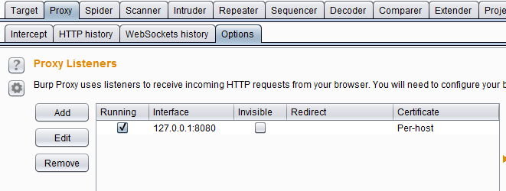
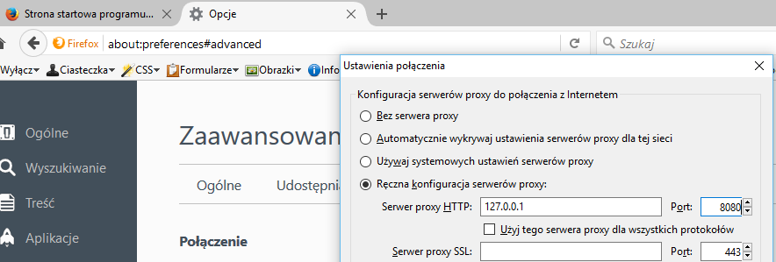
Burp 1/5 – Proxy configuration

Slide 33
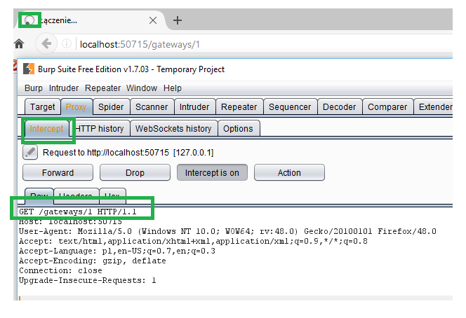
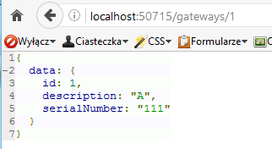
Burp 2/5 – Intercepting of requests

Slide 34
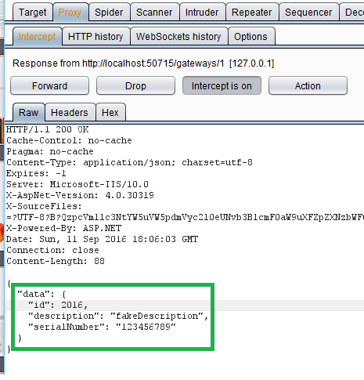
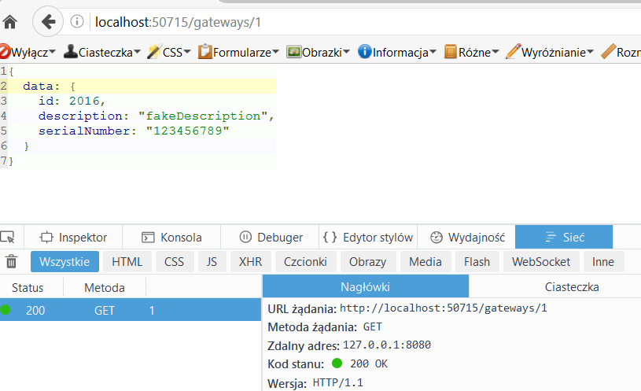
Burp 3/5 – Intercepting of responses

Slide 35
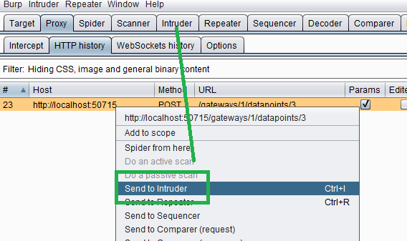
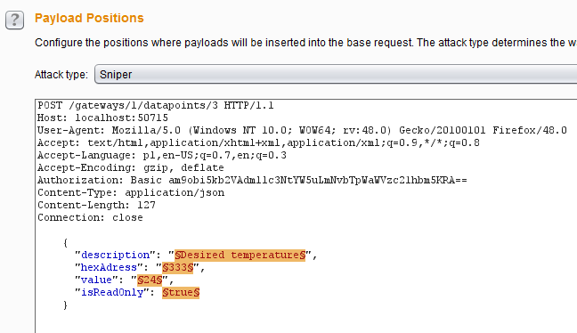
Burp 4/5 – Intruder

Slide 36
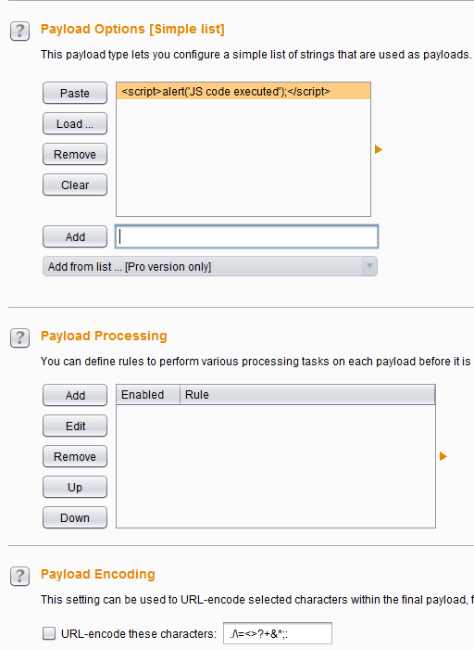
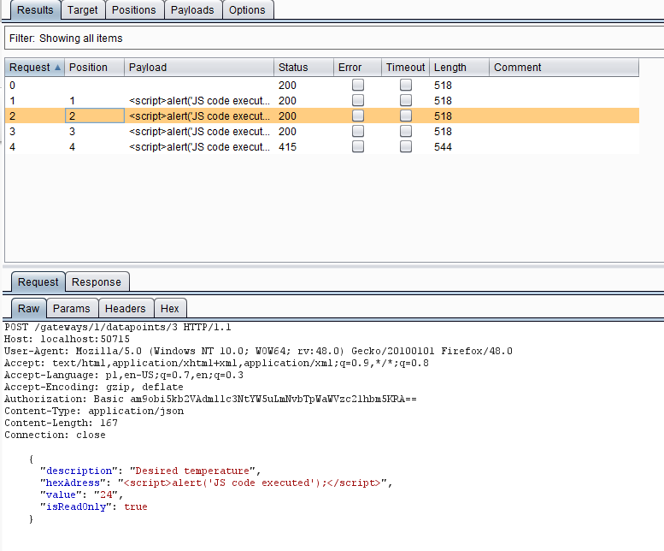

Burp 5/5 – Intruder

Slide 37
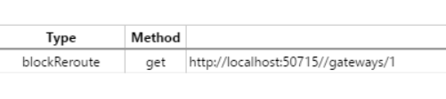
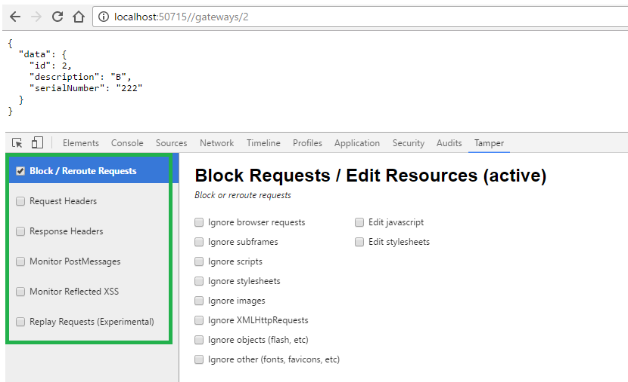
Alternatives - Tamper

Slide 38


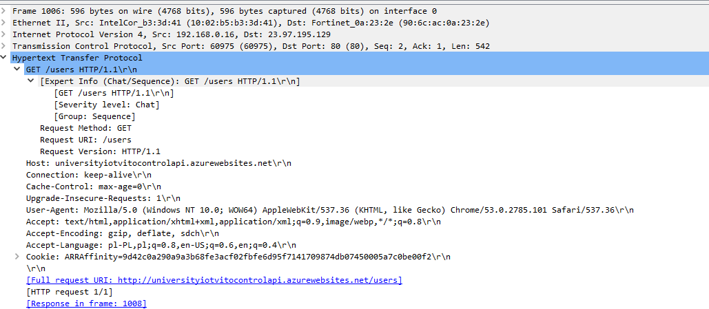
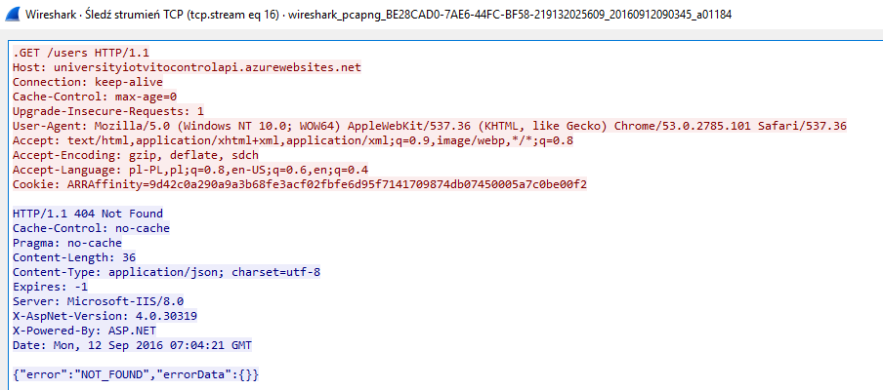
Packet sniffers
Wireshark
„http.request.method == GET or http.request.method == POST or http.request.method == PUT”
„Follow TCP Stream”
Module
Module
Module

Slide 39
Selenium Webdriver
API for controlling browser
Remote execution
Recording of tests

Slide 40
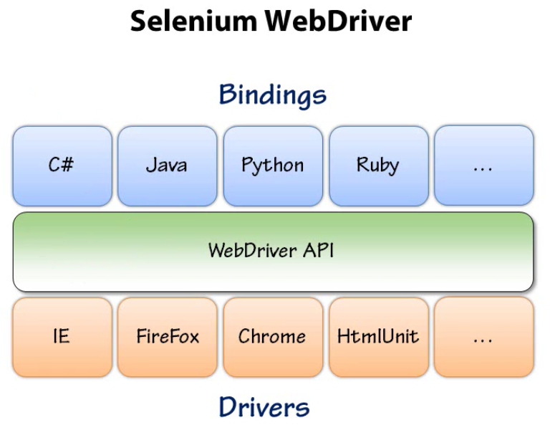
WebDriver architecture

Slide 41
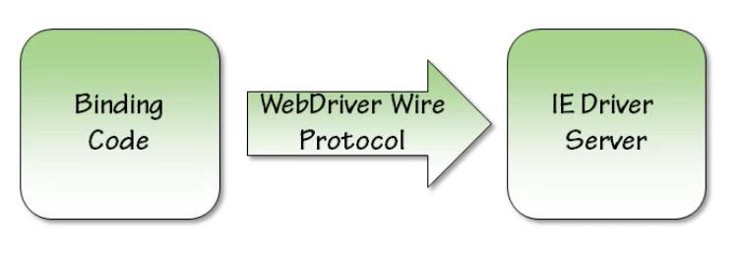
WebDriver communication

Slide 42
WebDriver api
WebDriver driver = new FirefoxDriver();
driver.get("http://www.google.com");
[FindsBy(How = How.Id, Using = "get-data")]
private IWebElement showTableButton;
showTableButton.Click();

Slide 43
DevOps
In traditional, functionally-separated organizations, there is rarely a cross-departmental integration of these functions with IT operations. But DevOps promotes a set of processes and methods for thinking about communication and collaboration—between departments of development, QA (quality assurance), and IT operations.

Slide 44
DevOps toolchain
Code — Code development and review, version control tools, code merging;
Build — Continuous integration tools, build status;
Test — Test and results determine performance;
Package — Artifact repository, application pre-deployment staging;
Release — Change management, release approvals, release automation;
Configure — Infrastructure configuration and management, Infrastructure–as–Code tools;
Monitor — Applications performance monitoring, end–user experience.

Slide 45
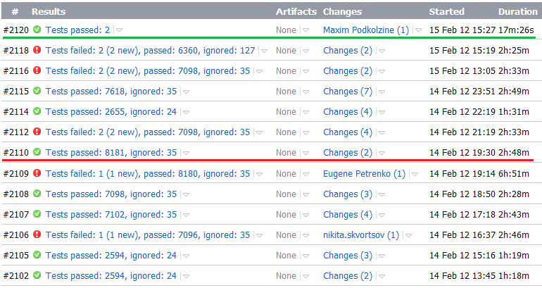
TeamCity/Jenkins

Slide 46
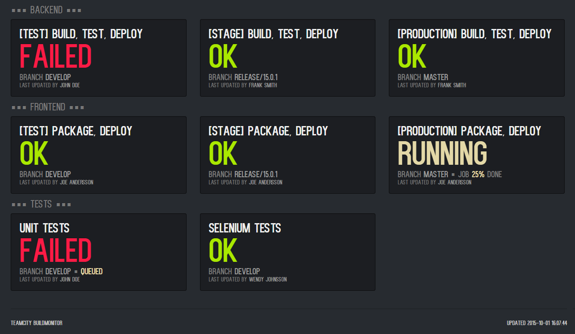
Status monitor

Slide 47
Materials
„Certified Tester Foundation Level Syllabus”, Released Version 2011, International Software Testing Qualifications Board Integration Testing Techniques, Kratika Parmar
„Słownik wyrażeń związanych z testowaniem”, Stowarzyszenie Jakości Systemów Informatycznych
Images under CC0 Public Domain
Other images
https://raw.githubusercontent.com/postmanlabs/postmanlabs.github.io/develop/global-artefacts/postman-logo%2Btext-320x132.png
https://www.google.pl/chrome/assets/common/images/chrome_logo_2x.png?mmfb=a5234ae3c4265f687c7fffae2760a907
https://curl.haxx.se/logo/curl-logo.svg
https://pbs.twimg.com/profile_images/428862239420841984/irhVslGA_400x400.png
https://encrypted-tbn1.gstatic.com/images?q=tbn:ANd9GcT6qgOlDGJZdzC8TRuK83Ane1U0-EkbhlhgTRCoXgwGe6RlT3yHZK3bWxk
http://d585tldpucybw.cloudfront.net/sfimages/default-source/productsimages/fiddler/fiddler-logo.png?sfvrsn=1
https://www.wireshark.org/assets/theme-2015/images/wireshark_logo.png

Slide 48
Thank you.

